Slide 1
GEOG-G489/589 Python Programming
Instructor: Natasha MacBean
String splitting and Introduction to Seaborn

Slide 2
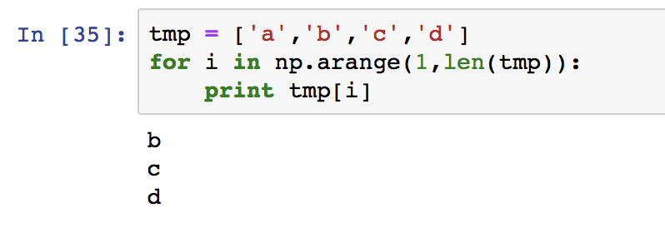
What if you don’t want to start at the beginning of a loop?

Slide 3
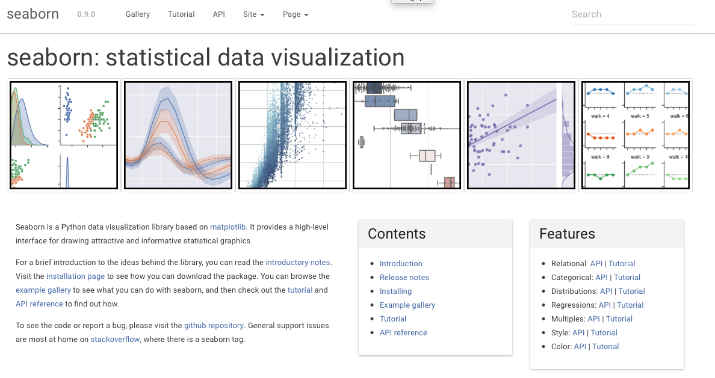
Seaborn plotting library
https://seaborn.pydata.org/index.html

Slide 4
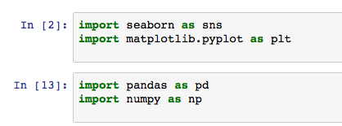
Loading seaborn

Slide 5
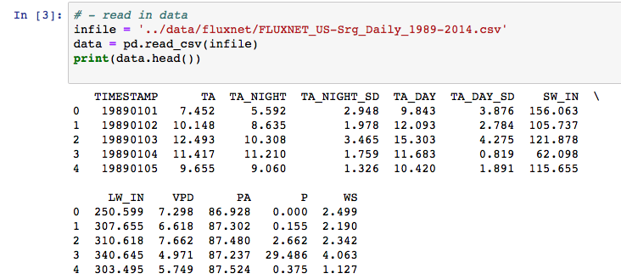
Read in data as normal…

Slide 6
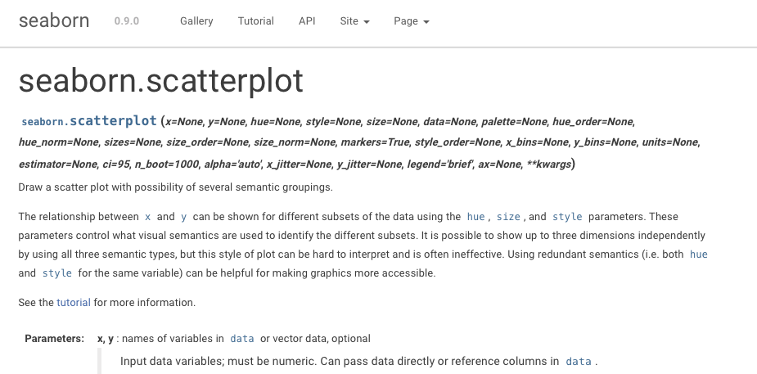
Simple seaborn commands Scatterplot

Slide 7
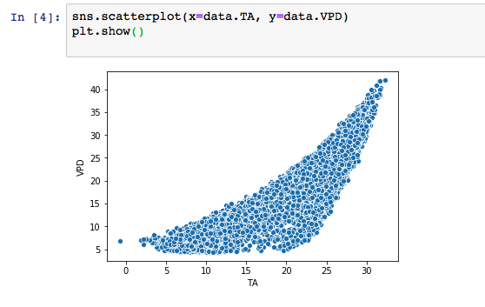
Simple seaborn commands → nice plots! Scatterplot
You can feed the specific columns of data into X and Y…

Slide 8
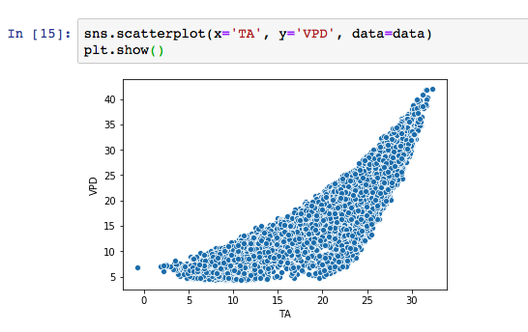
Simple seaborn commands → nice plots! Scatterplot
…OR you can also give X and Y the column header (title) *if* you also feed the dataframe into the variable “data”)
In both cases seaborn knew what to label the axes because it uses the column header information from the pandas dataframe

Slide 9
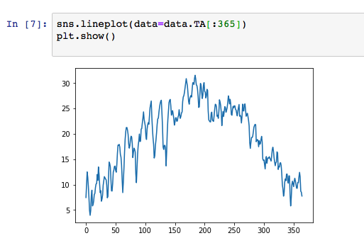
Lineplot

Slide 10
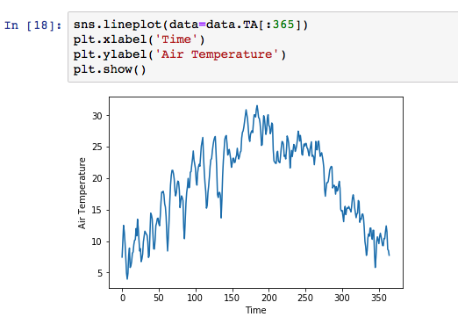
Lineplot

Slide 11
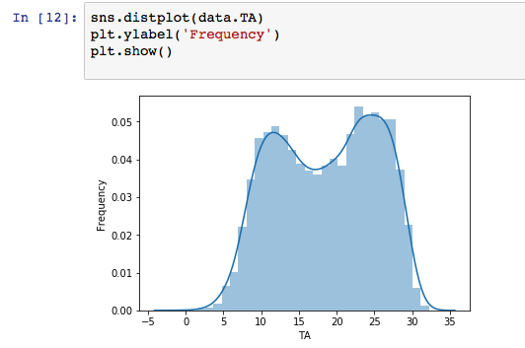
Histogram

Slide 12
5 mins to practice loading seaborn and simple plots…

Slide 13
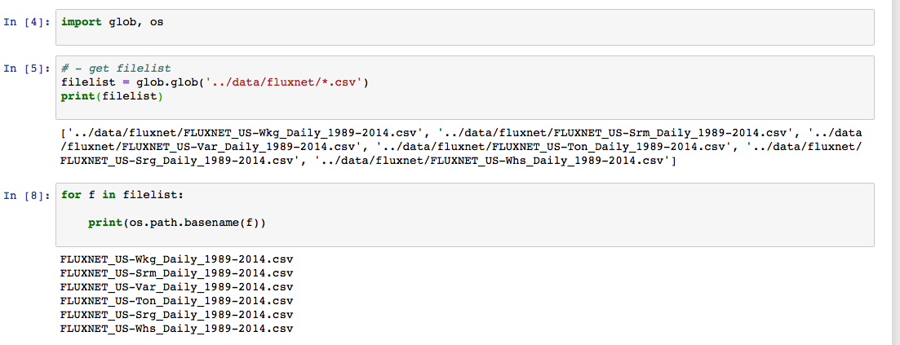
A mini segue into string splitting to get information from your filename (or change your filename)
os is another useful python library that connects to a range of operating system commands: https://docs.python.org/3/library/os.html
The command “basename” gets the filename and cuts out the rest of the file path…

Slide 14
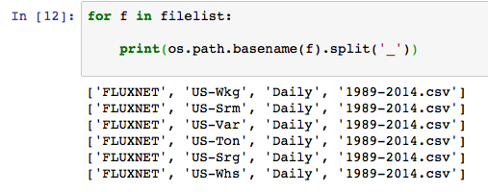
String splitting using the method “.split” string.split()
The argument in the split method is which character you want to use to split up the string, e.g. we have
FLUXNET_US-Wkg_Daily_1989-2014.csv
So here I split using the underscore…
The result is a list with each element containing the split string

Slide 15
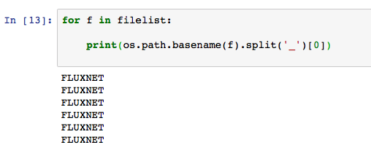
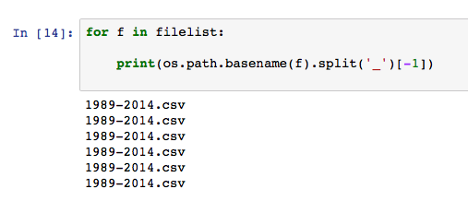
We can now index the list containing the split string to get at specific information

Slide 16
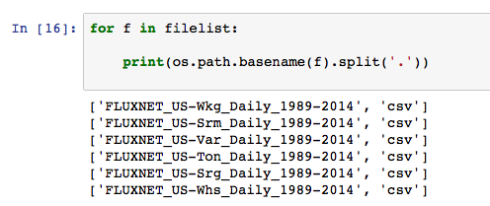
Splitting using different characters
Why might we want to remove the file extension?

Slide 17
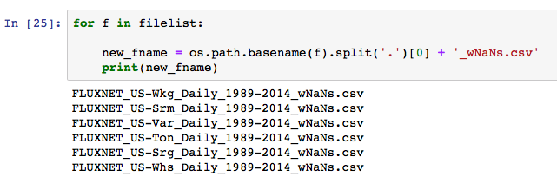
Using string split to create new filenames

Slide 18
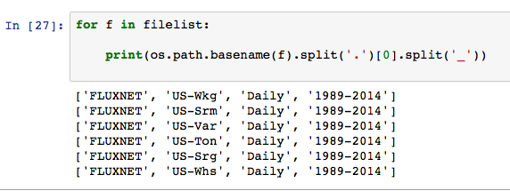
Splitting the string up further
You can keep splitting the string up further with extra split commands

Slide 19
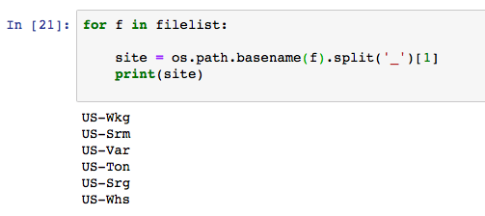
Accessing information from your filename using string.split()

Slide 20
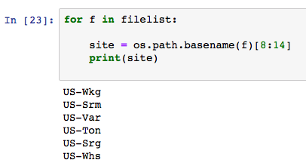
A different way of accessing information using slicing
You can slice the entire filename by the character indices

Slide 21
5-10 minute exercise
Create a loop like the one I have just shown you to access the “years” from the filename

Slide 22
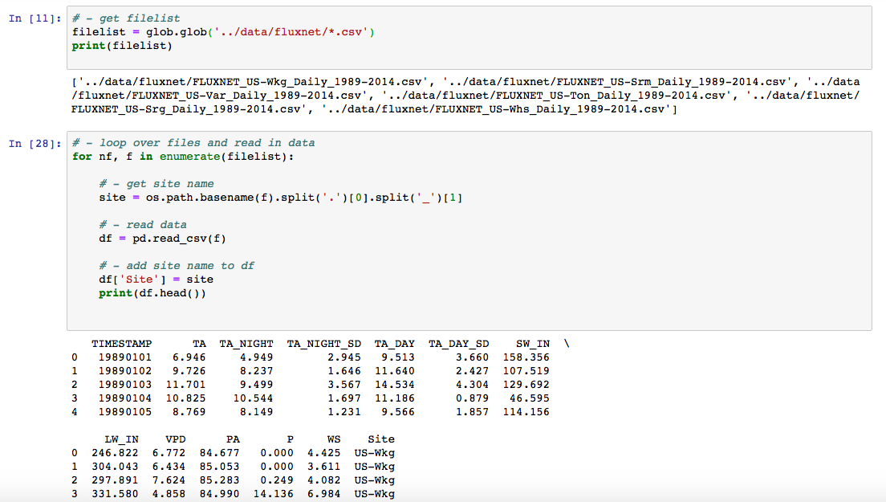
Seaborn plots to summarize information across sites
As you read in each file into a dataframe, you can add information to the dataframe about that file/site – in this case, just the site name
A new column will appear

Slide 23
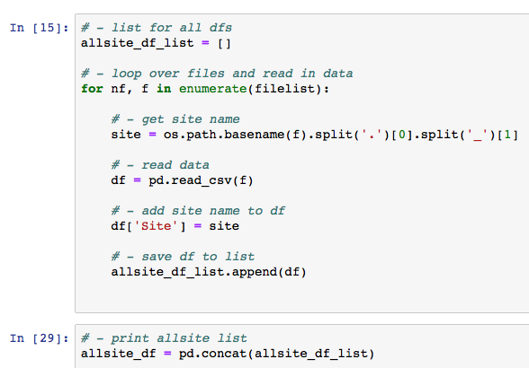
Saving dataframes to a list to concatenate multiple dfs
Append each dataframe to a list
Use pd.concat() method to concatenate that list to a new dataframe

Slide 24
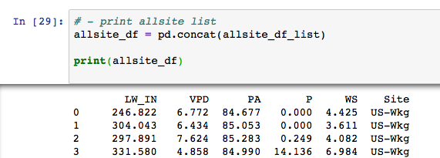
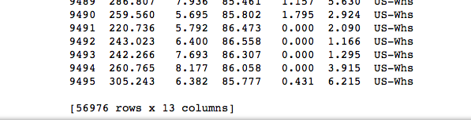
Saving dataframes to a list to concatenate multiple dfs
Now you have all the data for each site in the same dataframe!

Slide 25
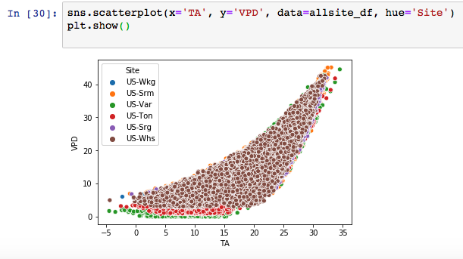
One of Seaborn’s powerful tricks – making use of that extra information while plotting with “hue” argument
Hue argument takes column name with which you want to separate your data → acts to create an easy legend

Slide 26
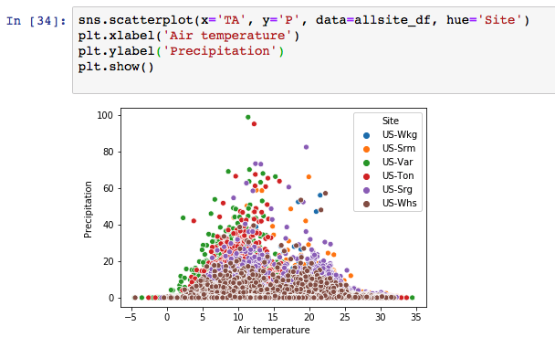
Another example

Slide 27
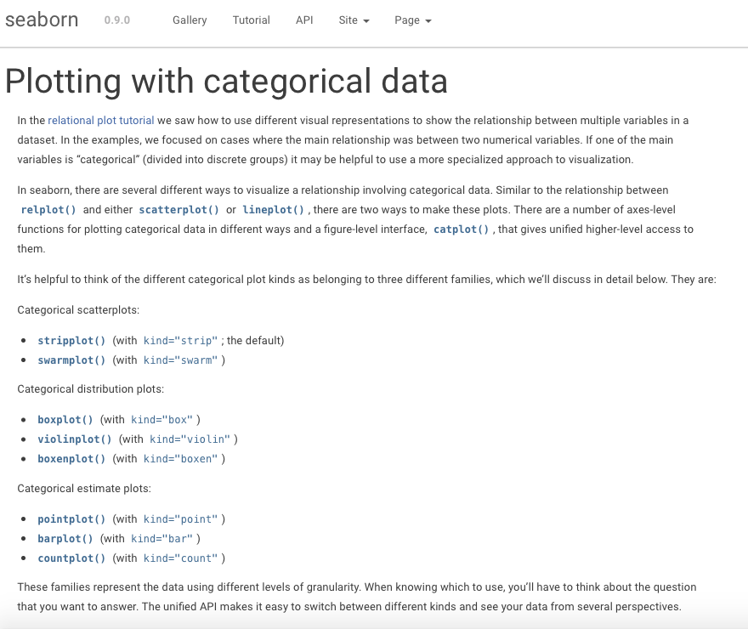
Categorical plots in Seaborn

Slide 28
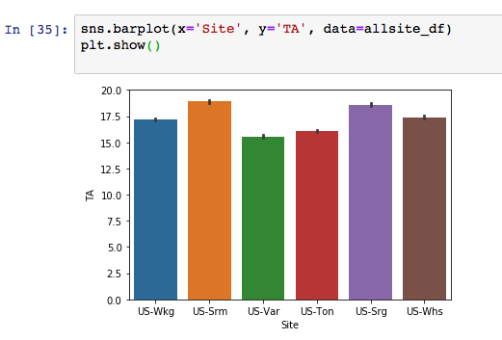
Categorical plots in Seaborn barplots for means and errors

Slide 29
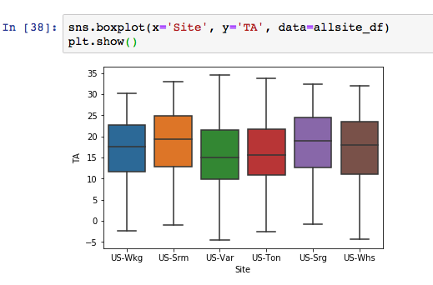
Categorical plots in Seaborn boxplots for medians and inter-quartile ranges

Slide 30
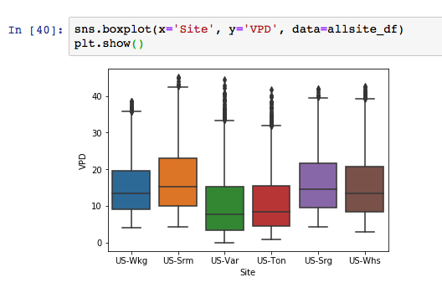
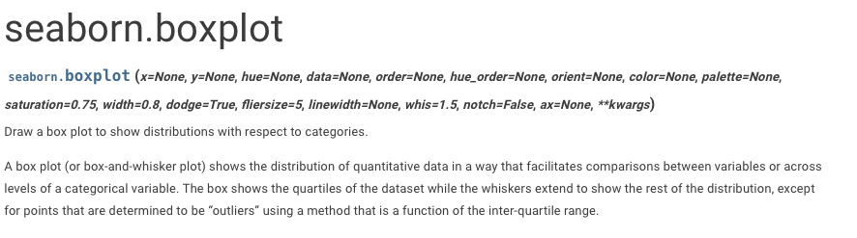

Categorical plots in Seaborn boxplots for medians and inter-quartile ranges

Slide 31
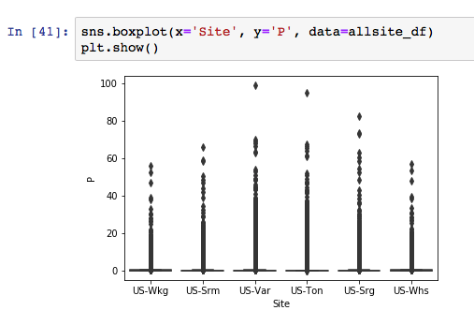
Categorical plots in Seaborn boxplots for medians and inter-quartile ranges

Slide 32
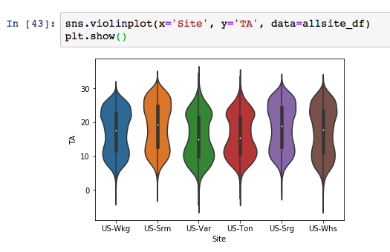
Categorical plots in Seaborn violinplots for distributions

Slide 33
Use the remaining time in class to practice…
Creating a loop to read in all the site information and saving it to one dataframe
Creating seaborn plots to summarize statistics across each sites using the examples from class.

